Slide 1



Detection for Twitter Cyberbullying using ML
Courage is fire and bullying is smoke

Slide 2


Mohd abdul khader (7019)
Fahad khan (7013)
Mohammed Shaare uddin(7032)
Guide : Mrs Reshma Mam

Slide 3








Introduction
@intro
Technology shapes our lives, fostering communication through social media. However, cyberbullying is rampant, affecting 37% of Indian children emotionally and psychologically.
150
15k
100
Introduction
@intro
Empower against Twitter cyberbullying with our detection website, ensuring a safe online environment through advanced monitoring and reporting mechanisms.
150
15k
100

Slide 4

Existing System
For several years, the researchers have worked intensively on cyberbullying detection to find a way to control or reduce cyberbullying in social media platforms
Generally most existing system are focused on effects after cyberbullying incident and there is no accurate system for online cyberbullying detection.
Spread of Misinformation

Slide 5
Proposed System
The Proposed system employs machine learning to avoid human intervention
a dataset containing cyberbullying and non bullying comments is used to train the machine learing model using the sklearn library in python
Naive bayes algorithms is used for detection abusive comments and messages in social media

Slide 6
The naive bayes algorithm states that: p(A/B)=(p(B/A)p(A))/p(B)
In the proposed system automated detection of bullying comments in social media is implemented.
The proposed system is platform independent, it can be implemented on any operating system and it is free to use.

Slide 7


ADVANTAGES OF PROPOSED SYSTEM
EFFICIENCY
ACCURACY
REAL-TIME DETECTION

Slide 8
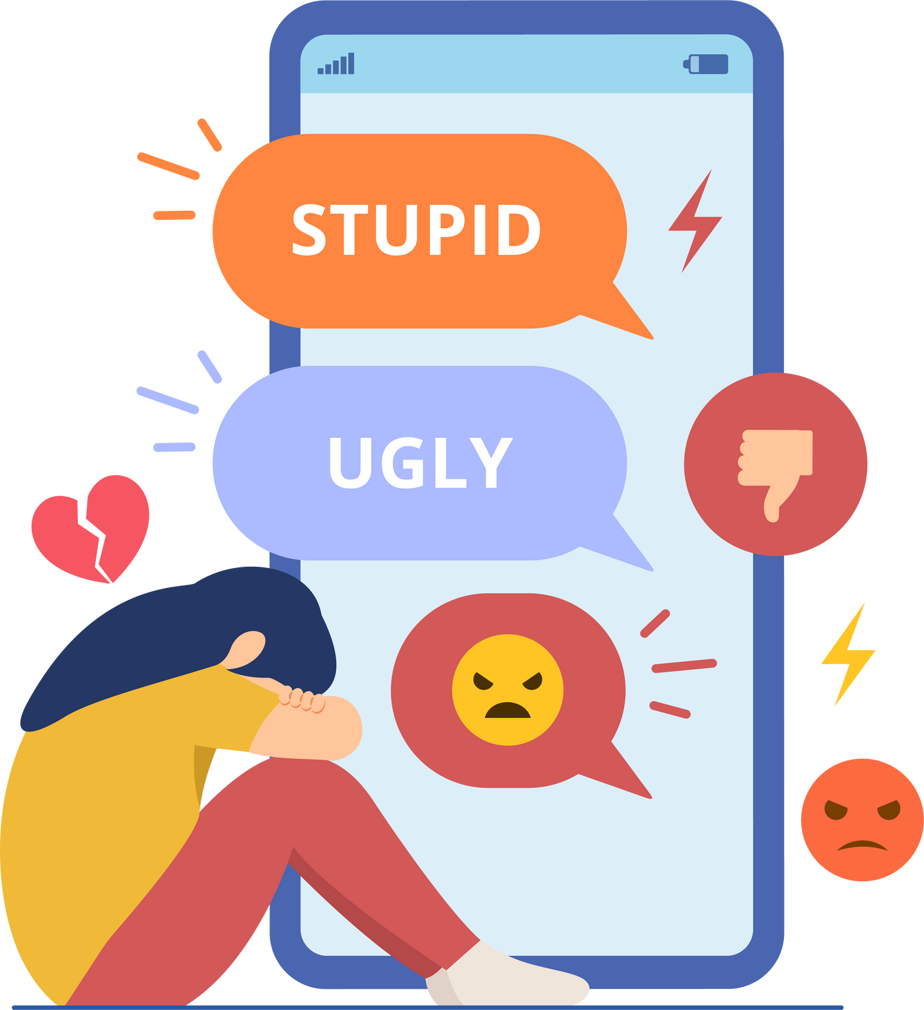


SOFTWARE AND HARDWARE REUIREMENTS
@Requirements
HARDWARE REQUIREMENTS:
System : Intel i3
Hard Disk : 1 TB.
vRam : 4GB.
SOFTWARE REQUIREMENTS:
Operating system : Windows 10 / Linux
Coding Language : Python.
Front-End : Html. CSS
Designing : Html,css,javascript.
Data Base : SQLite.
Libraries : Pandas, Numpy, Sklearn, Linear regression
#Software requirements #hardware
150
15k
100

Slide 9
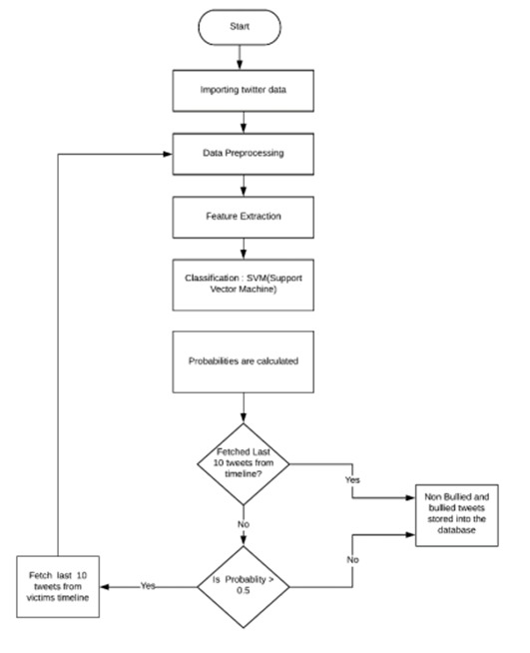
System Architecture

Slide 10
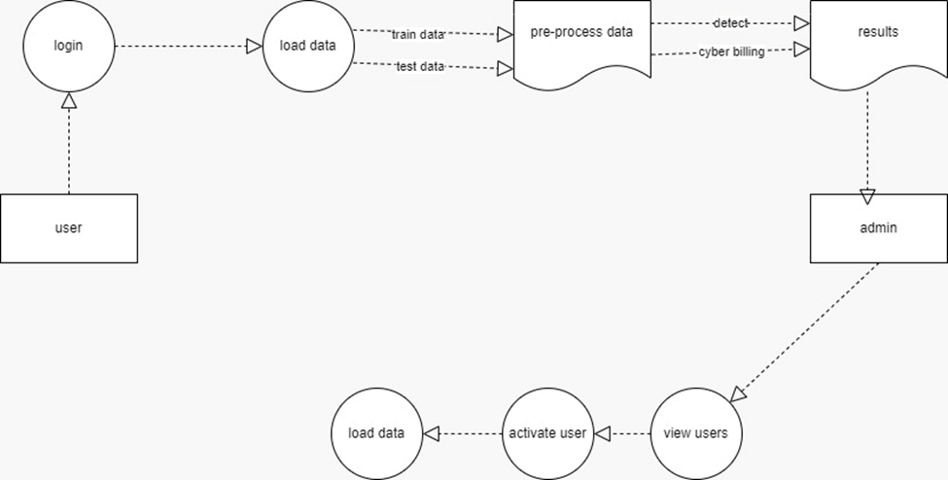
UML Diagram

Slide 11
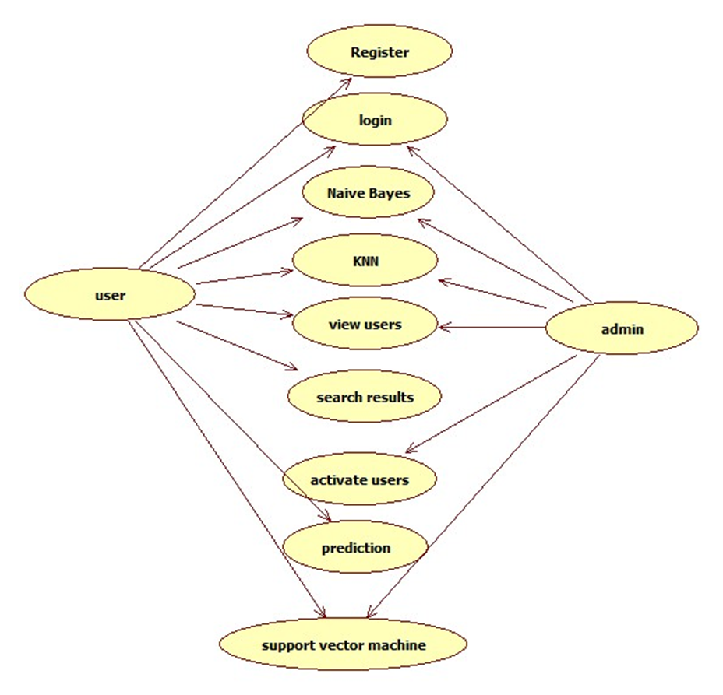
Use Case Diagram

Slide 12
User: Register with valid email and mobile. Admin activates users for login. Upload and preprocess datasets. Add new data via Django app.
Admin: Login, activate users, view and load data. Monitor training and test data. Access forecast results on our Django application.
Data Preprocessing: Prepare, analyze, and model Twitter data with features like sentiment, topic, and NLP. Utilize a pipeline for comprehensive insights.
Machine Learning: Split cleaned data, train with NLP classifiers. Fine-tune BERT and ALBERT for sentiment analysis, providing contextual insights into public sentiment.
Modules and Functions

Slide 13
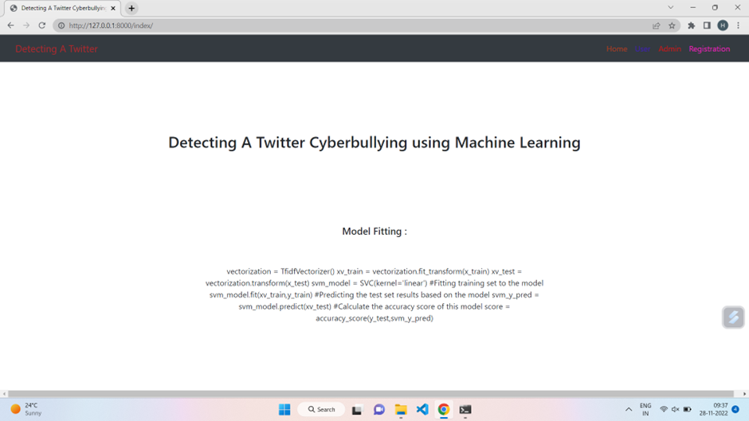
Screen shots

Slide 14
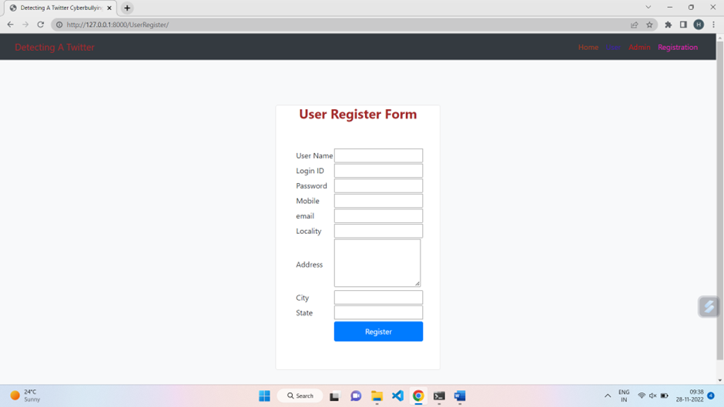
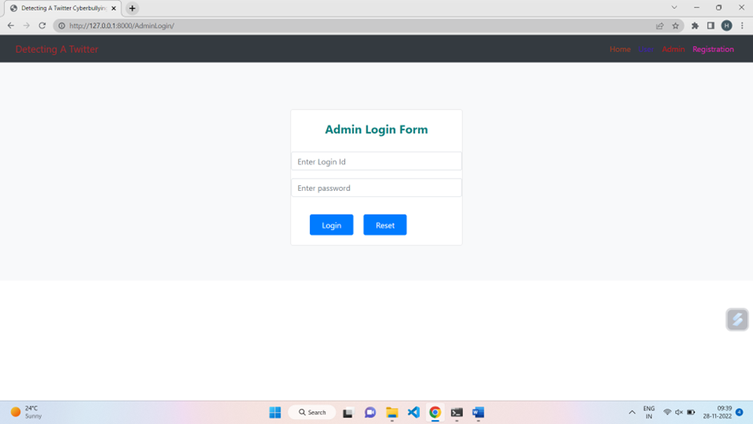

Slide 15
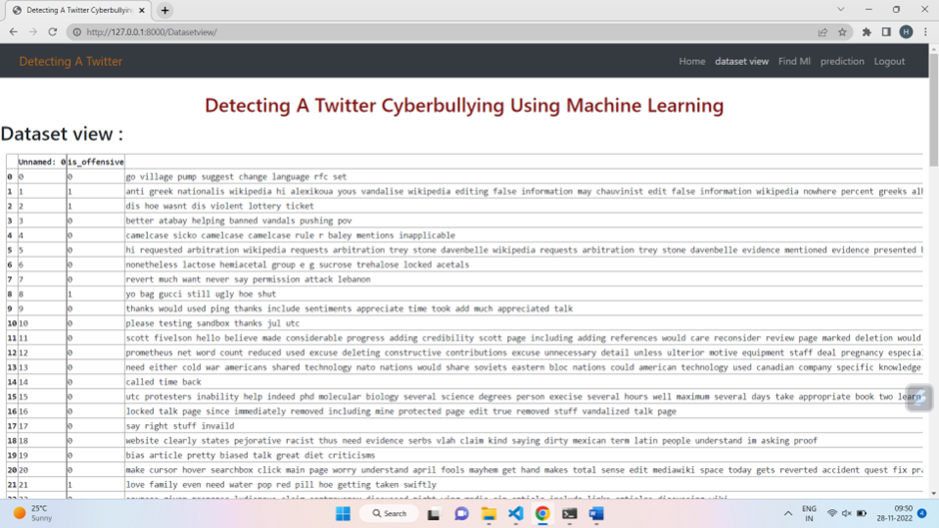

Slide 16
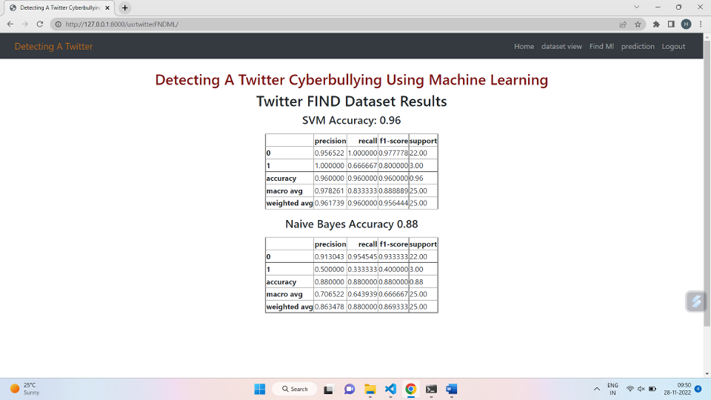

Slide 17
Conclusion
An approach is proposed for detecting and preventing Twitter cyberbullying using Supervised Binary classification Machine Learning algorithms. Our model is evaluated on both Support Vector Machine and Naive Bayes, also for feature extraction, used the TFIDF vectorizer. As the results show us that the accuracy for detecting cyberbullying content has also been great for Support Vector Machine of around 71.25% which is better than Naive Bayes. Our model will help people from the attacks of social media bullies.

Slide 18

FUTURE ENHANCEMENT:
In future iterations of our Twitter Cyberbullying Detection Website, we aim to enhance the system's capabilities by integrating multimodal analysis for images and videos, refining sentiment analysis for nuanced language, and incorporating contextual understanding to discern the intent of conversations. We also plan to introduce behavioral analysis, machine learning explainability, and multilingual support. Collaboration with mental health professionals, blockchain integration for data security, and empowering users with advanced customization tools are key components for a more robust cyberbullying prevention platform.

Slide 19
Thank you

